Slide 1
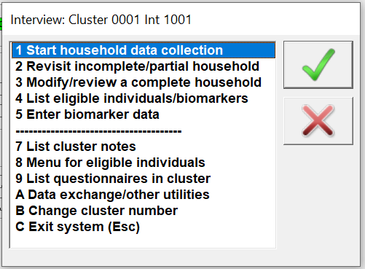
CAPI Menus
Supervisors and Interviewers

Slide 2
CAPI Menu: What? Why? When? Who? How?
What? Accessing all CAPI functions through a menu system
Why? Simplify work, set up identifiers for the data
When? Before performing any survey activities, access the menu
Who? Everybody! Supervisors and interviewers each have menus
How? Use passwords and find the link to the menu on the desktop
Notes:
“identifiers” for the data – meaning who did the interviewers, which teams they are on, which cluster they are in, etc…
Note that if supervisors are acting as interviewers, they should access the interviewer menu

Slide 3



Steps in accessing the CAPI menus
Navigate to the desktop and double-click on the appropriate icon.
- Interviewer and Supervisor
Enter information to identify cluster and team
Begin work!
Notes:
If not already, have people move around to be in teams….

Slide 4
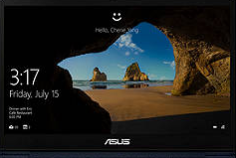

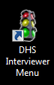
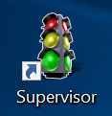
Find the CAPI icons
Double click on appropriate icon from desktop:
Click desktop “application”
Notes:
Note that whenever supervisors wish to carry out interviews, they should use their interviewer icon to do so
Note sometimes Supervisor uses IFFS icon to access the menu.

Slide 5
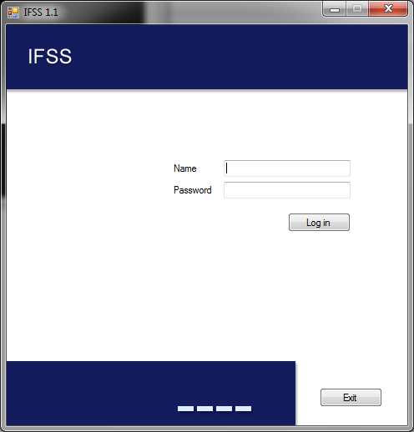
Supervisor log-in using IFSS icon
Name:
Super1
Super2
Super3
…
Super18
Super19
Superxx
Password:
cc20xx
Notes:
Name is “Superv” + team number

Slide 6
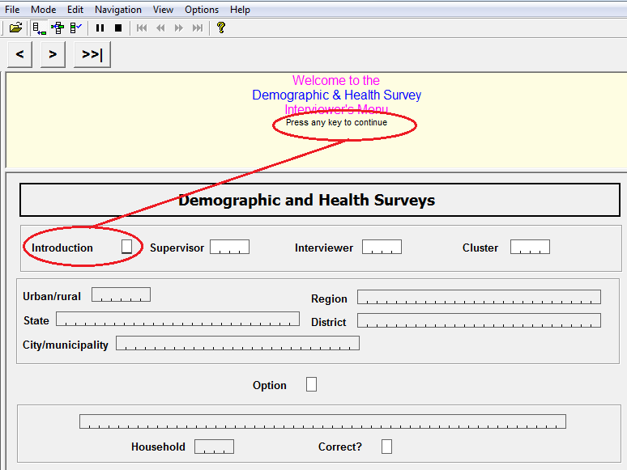
Enter correct information
When requested to press any key, use the enter key or spacebar

Slide 7
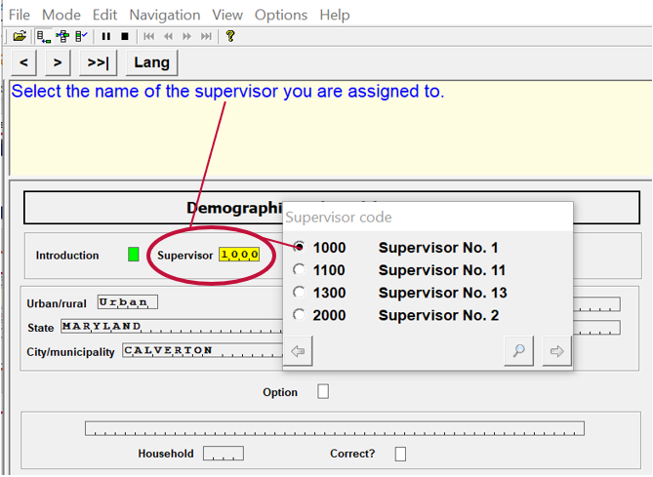
Enter correct information
Choose team supervisor from list

Slide 8
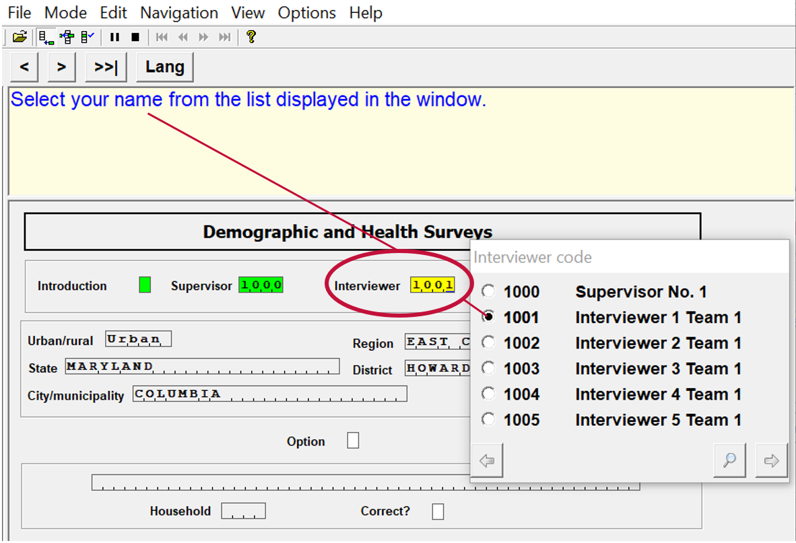
Enter correct information
Choose name from interviewer list
Notes:
Choose your own name!! Weirdly people do mess it up….

Slide 9
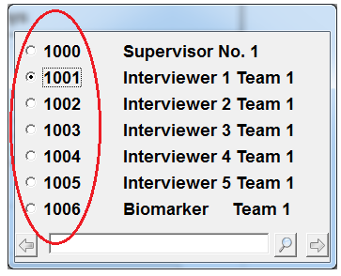
Fieldworker Numbers
Fieldworker number….
MEMORIZE IT. THE SYSTEM WILL REMEMBER
Notes:
Make sure everyone in class knows their FW number – go around the room and have them say it outloud!

Slide 10
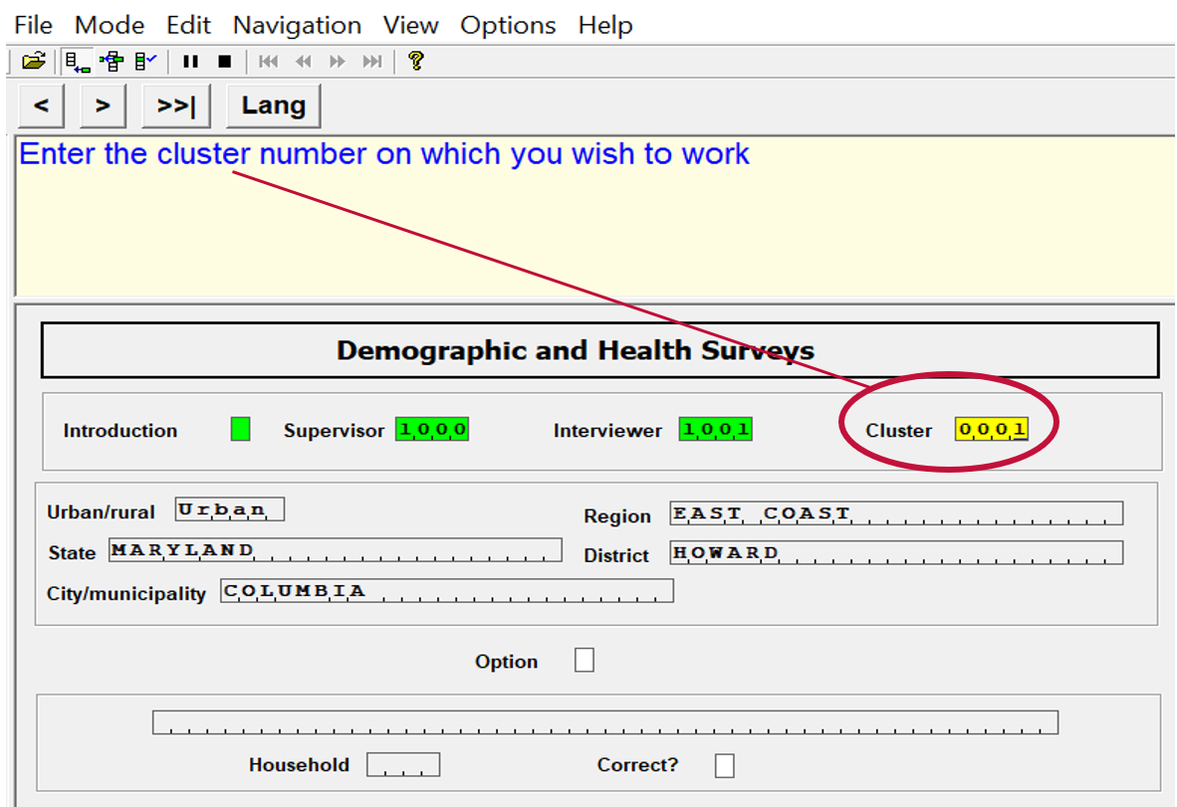
Enter correct information
Type in cluster number – MUST be correct

Slide 11
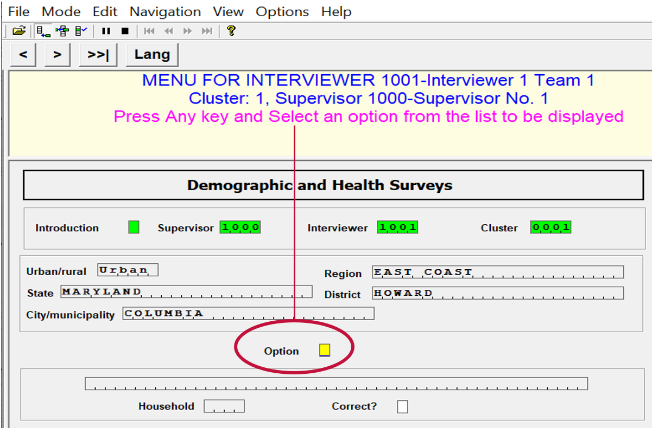
Enter correct information
Press any key to continue
Notes:
ALL INFORMATION MUST MUST MUST BE CORRECT…
Why? What could happen?
Can’t locate previous work, work will be assigned to wrong cluster, can’t find households, can’t transfer data, assign your work to your teammate, etc etc… basically everything won’t work!

Slide 12
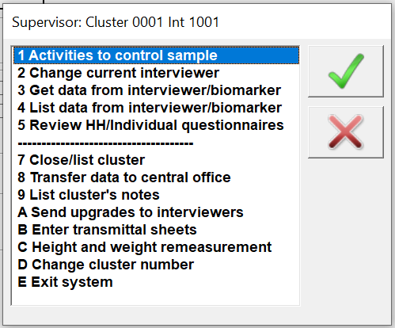

Begin work!
Supervisor menu
Interviewer menu
Note: When supervisors do interviews, they should use interviewer menu…
Notes:
Everything you need to do can be found in these two menus………

Slide 13

Practice time!
Access the appropriate menu using correct supervisor, interviewer, and cluster… then Exit properly!
Cluster 0002
Write FW code down!

